Slide 1
Prepared for: WASHOE COUNTY COMMUNITY SERVICES DEPARTMENT, PLANNING AND Development DIVISION
Re: CAB MEETING for WSUP16-001 regarding removal of landslide material from properties

Slide 2
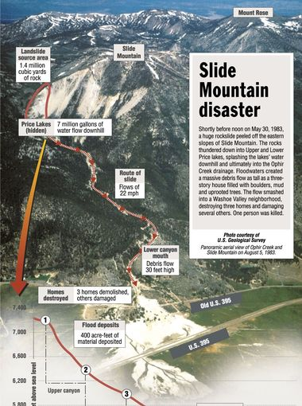
1983 Slide Mountain Disaster
Diagram showing origin and affected area of the rock slide from Slide Mountain.
Area of rock deposit shown near flood deposit location marked on this illustration.

Slide 3
On Memorial Day 19183, Slide Mountain lived up to its name. Snow, dirt and rock crashed into Upper and Lower Rice Lakes, emptying them of hundreds of thousands of gallons of water and sending a 30-foot wall of debris down the Ophir Creek drainage into Northwestern Washoe Valley. A house, truck and school bus were among the casualties.

Slide 4
San Francisco television cameraman Willie Kee is pulled after a portion of Slide Mountain gave way on Memorial Day 1983, taking out Price Lake and sending a torrent of mud, water trees and boulders down the mountainside and across the valley, including U.S Hwy 395.

Slide 5
Old U.S. Hwy 395 Looking north from Bowers Mansion after the road was buried in mud when part of Slide Mountain gave way on Memorial Day, May 30, 1983.

Slide 6
A horse, overtaken by the rushing wall of mud that cascaded down the canyon and into Washoe Valley below, was facing imminent death when dramatically rescued by helicopter on Memorial Day 1983

Slide 7
A truck lies in the mud where it came to rest after part of Slide Mountain gave way on Memorial Day 1983

Slide 8
Mud clogged U.S. Hwy 395 in the middle of Washoe Valley, looking south toward Carson City on May 30

Slide 9
In this 2003 photo, Pat Glancy sits atop a huge pile of rocks that came from the May 30, 1983, DSlide Mountain mudslide. The area the slide originated at is the lighter triangle on the far left side of the mountain in the background.

